Slide 1
San Luis Rey de Francia Business Meeting
May 5, 2021

Slide 2
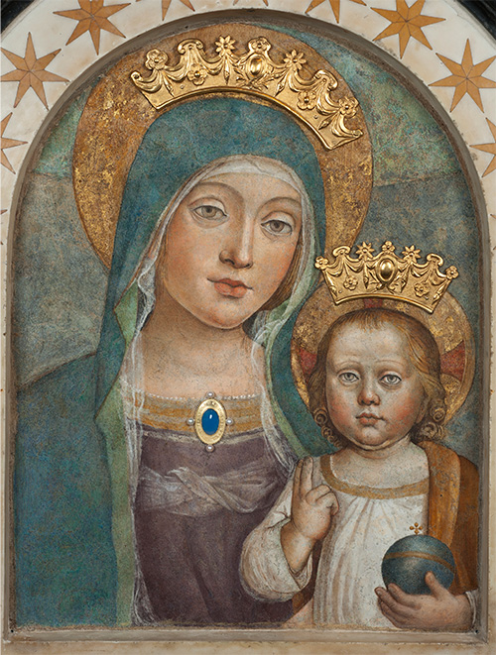
A PRAYER FOR PROTECTION IN TIME OF PANDEMIC

Slide 3
O Mary,
you always brighten our path as a sign of salvation and of hope.
We entrust ourselves to you,
Health of the Sick,
who, at the Cross,
took part in Jesus’ pain
while remaining steadfast in faith.

Slide 4
O loving Mother,
you know what we need,
and we are confident you will provide for us as at Cana in Galilee.
Intercede for us with your Son Jesus,
the Divine Physician,
for those who have fallen ill,
for those who are vulnerable,
and for those who have died.

Slide 5
Intercede also for those charged with protecting the health and safety of others
and for those who are tending to the sick and seeking a cure.
Help us, O Mother of Divine Love,
to conform to the will of the Father
and to do as we are told by Jesus,
who took upon Himself our sufferings and carried our sorrows,

Slide 6
so as to lead us, through the Cross,
to the glory of the Resurrection.
Amen.
Under thy protection we seek refuge,
O Holy Mother of God.
In our needs, despise not our petitions,
but deliver us always from all dangers,
O glorious and blessed Virgin.
Amen.

Slide 7
Pledge of Allegiance-Ed Bagon
I pledge allegiance to the flag
of the United States of America
and to the Republic
for which it stands
one Nation under God,
indivisible,
with liberty and justice for all.

Slide 8
Pledge of Allegiance to the Cross of Christ Steve Kimball
I pledge allegiance to the Cross of Christ and to the faith for which it stands, one Holy, Catholic and Apostolic, with grace and salvation for all. Amen

Slide 9
Roll Call of Officers
GK Advocate
DGK Warden
Chancellor Inside Guard
Recorder Outside Guard
Financial Secretary Trustee One Year
Treasurer Trustee Two Year
Lector Trustee Three Year

Slide 10
Approval of Minutes
Motion to Approve Minutes as Posted
Motion Seconded
Motion Approved/Disapproved

Slide 11
Report on Admissions/Membership Committee
Eugene Garcia
New Applications/Online-
Transfer Landon Perzee
Readmissions
Affirm Reapplication
Membership Drive

Slide 12
Pastor’s Report
Mission San Luis Rey Parish
Pastoral Plan 2021-2022
Mission Statement
In the Spirit of St. Francis, and as Catholics in a community of many cultures, we live the gospel of Jesus Christ. Strengthened by Word and Sacrament, we welcome all into God’s inclusive love. We serve the poor, care for creation and build a just and compassionate world.
Goals and Objectives Goal 1: Evangelization
Create a spirit of Franciscan hospitality in all parish ministries and events.
Objective 1: Identify a minimum of sixteen (16) family welcome teams to greet people at the Sunday/Weekend Masses.
Objective 2: Develop a “Hospitality/Welcome” protocol for all large/all-parish social events, and share it with parish event planners.
Objective 3: Each parish ministry will develop its own hospitality plan.
Goal 2: Community
Ensure the inclusion and participation of different cultures in every aspect of parish life.
Objective 1: Foster opportunities for parishioners to develop multicultural friendships.
Objective 2: Provide educational opportunities for parishioners to learn about other cultures.
Objective 3: Support and enhance the Cultural and Diversity Council to create more social contacts between parishioners from different cultural groups - to build a greater sense of unity among all parishioners.
Objective 4: Provide formation and preparation so parishioners may better engage in multicultural liturgies.

Slide 13
Grand Knights Report Armando L. Mena
Welcome
Review
Thank You

Slide 14
Treasurer’s Report Ed Bagon
TOTAL BIM ACCOUNT |  | 19,162.57
AVAILABLE CHECKING BALANCE |  | 16,705.05
TOTAL ASSETS |  | 35,867.62
DEPOSITS |  | 490.25
INTEREST (Savings/Checking) |  |  |  | 0.45
TOTAL INCOME |  | 490.70
EXPENSES |  | 604.55
$35,127

Slide 15
Trustees Report Jesus Lego
Candidates for Columbian Year 21-22 please submit names or nominations starting April 1, 2021
Council Elections will be held on June 2, 2021 at hybrid meeting at 7:30 PM. Columbus club elections held after council meeting
List of Interested Candidate who submitted their names

Slide 16
The Columbiettes
A presentation by Carla Trevino

Slide 17
Knights on Bikes
A presentation
By
Raj

Slide 18
Programs Reports
Sage Chavez Deputy Grand Knight
Community -SK Gilbert Alvarez
Squires & Roses
Family Bro. Rich Hirasuna
K Family Rosary on March 16
FFF
Faith SK Sage Chavez
Into the Breach
Adoration Program
Semenarian Check Presentation
Life SK Armando Mena
Mobile on Parish

Slide 19
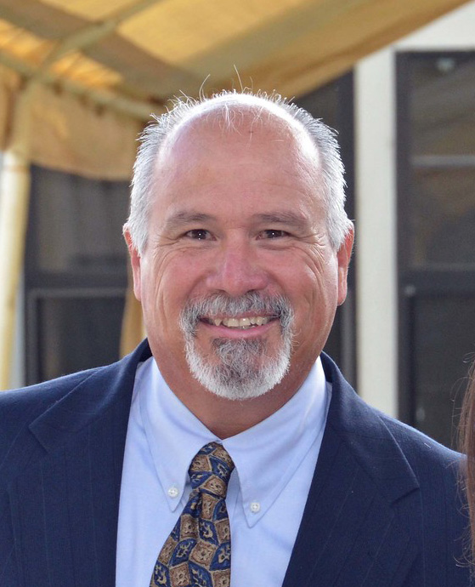
community Gilbert Alvarez

Slide 20
Family Richard Hirasuna
Monthly Rosary May 20th at 7:30 PM via ZOOM . Invitation for June family is extended.
Food for Families. Five families from council have now contributed over 1540 pounds of food since July 1, 2020.

Slide 21
Life
Birth choice
Mobile
Imaging
Bob Convoy agrees to drive the Birth Choice Mobile MRI unit on parish

Slide 22
Unfinished Business
Corporate Communion
Crusader
Seminarian Check Presentation Sunday May 9

Slide 23
New Business
.t
COUNCIL CALENDAR MAY 2021 (ALL EVENTS WILL BE DETAILED IN FLOCKNOTES/ EMAILS)
WEDNESDAY MAY 5 7:30 PM COUNCIL BUSINESS MEETING LIVE AT ST. MICHAEL’S COURT/ZOOM
THURSDAY MAY 6 9 AM HOLY HOUR (ADORATION). CONTACT SAGE CHAVEZ 760-429- 4527 sagechavez@yahoo.com
THURSDAY MAY 6 7 PM INTO THE BREACH VIA ZOOM. CONTACT SAGE CHAVEZ 760-429- 4527 sagechavez@yahoo.com
SATURDAY MAY 8 2 PM SQUIRES/ROSES MEETING MOTHER’S DAY ROSARY LOCATION TBD/ZOOM
SUNDAY MAY 9 10 AM CORPORATE COMMUNION SERRA CENTER (WE WILL BE SITTING IN FRONT OF ADORATION CHAPEL) AND RECEPTION FOR SEMENARIANS AT BBQ AREA AFTER MASS LIVE.
TUESDAY MAY 11 7:30 PM FR. PEYRI ASSEMBLY MEETING AND ELECTIONS ZOOM
FRIDAY MAY 14 7 PM SPANISH EXEMPLIFICATION TBD
SATURDAY MAY 15 10 AM STATEWIDE EXEMPLIFICATIONS VIA ZOOM
SATURDAY MAY 15 3 PM SILVER ROSE OF GUADALUPE TRANSFER AND CEREMONY MISSION SAN LUIS REY AND SAN LUIS REY CEMETERY. FR. ANTHONY GARABALDI CELEBRANT- LIVE/ZOOM
THURSDAY MAY 20 7:30 PM FAMILY ROSARY VIA ZOOM CONTACT RICHARD HIRASUNA 619-248-3478
richhirasuna@yahoo.com
WEDNESDAY MAY 26 7:30 PM OFFICERS HYBRID MEETING VIA ZOOM/LIVE. ALL MEMBERS CAN ATTEND. OFFICERS’ REPORTS DUE. CONTACT GRAND KNIGHT ARMANDO MENA americanaztec@sbcglobal.net
WEDNESDAY JUNE 2 7:30 PM BUSINESS MEETING LIVE/ZOOM AT KOFC HALL OR ST. MICHAEL’S COURT. THIS IS THE OFFICIAL NOTIFICATION OF COUNCIL # 3162 ELECTIONS. THIS THE OFFICIAL NOTIFICATION THE COLUMBUS CLUB ELECTIONS TO BE HELD AFTER THE COUNCIL MEETING. CONTACT GRAND KNIGHT ARMANDO MENA americanaztec@sbcglobal.net

Slide 24
NEW BUSINESS CONT.
KofC Council 3162 2021-2022 Candidates for Office List
GRAND KNIGHT PGK RICK LEWIS
DEPUTY GRAND KNIGHT RICK CARON
CHANCELLOR PGK RICK SHARP
WARDEN TALA PAULO
TREASURER ED BAGON
RECORDER DON WATTERS
ADVOCATE DON DIAZ
INSIDE GUARD DON NAFFZIGER
OUTSIDE GUARD STEPHEN KIMBALL
3RD YEAR TRUSTEE PGK DAVID DIAZ JR.
2ND YEAR TRUSTEE JESUS LEGO
1ST YEAR TRUSTEE PGK DAVID AUSTIN
ANYONE WHO WISHES TO RUN CAN BE NOMINATED FROM FLOOR

Slide 25
March Calendar Con’t
SATURDAY MARCH 27 10:00 EXEMPLIFICATION OF CHARITY, UNITY AND FRATERNITY AT ST. LUKES WITH SAN DIEGO DIOCESE MOST REV. BISHOP JOHN DOLAN details will be on flocknotes
WEDNESDAY MARCH 31 7:30 PM OFFICERS HYBRID MEETING VIA ZOOM/LIVE. ALL MEMBERS CAN ATTEND. OFFICERS’ REPORTS DUE. CONTACT GRAND KNIGHT ARMANDO MENA americanaztec@sbcglobal.net
WEDNESDAY APRIL 7 BUSINESS MEETING. OPEN GUESTS KOFC INSURANCE FIELSD AGENT RON RESTAINO AND PARISH COORDINATOR CONSECRATION OF ST. JOSEPH ANDY DOMINGO, JR. THIS WILL BE INSURANCE BENEFITS PRESENTATION. CONTACT GRAND KNIGHT ARMANDO MENA americanaztec@sbcglobal.net

Slide 26
Report of the Fourth Degree
Sage Chavez Council 4th Degree Advocate
FR. PEYRI ASSEMBLY MEETS SECOND TUESDAY OF MONTH 5/11/21 AT 7:30 PM ON ZOOM
ELECTIONS FOR ASSEMBLY OFFICER CANDIDATES WILL BE HELD MAY 11, 2021 SEE SK SAGE CHAVEZ

Slide 27
Good of the Order
Awards
Knight of the Month
Family of the Month

Slide 28
Closing Prayer
Prayer for Canonization of Fr. Michael J. McGivney

Slide 29
God, our Father,
protector of the poor
and defender of the widow and orphan,
you called your priest,
Father Michael J. McGivney,
to be an apostle of Christian family life
and to lead the young
to the generous service of their neighbor.

Slide 30
Through the example of his life and virtue
may we follow your Son,
Jesus Christ,
more closely,
fulfilling his commandment of charity
and building up his Body which is the Church.

Slide 31
Let the inspiration of your servant
prompt us to greater confidence in your love
so that we may continue his work
of caring for the needy and the outcast.
We humbly ask
that you glorify
Blessed Father Michael J. McGivney
on earth

Slide 32
according to the design of your holy will.
Through his intercession,
grant the favor I now present
(here make your request).
Through Christ our Lord. Amen.
(Our Father, Hail Mary, Glory be.)

Slide 33
Meeting Adjourned

